Slide 1
HIV
Weston Hanks

Slide 2
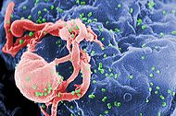
HUMAN IMMUNODEFICIENCY VIRUS
Scanning electron micrograph of HIV-1 (in green) budding from cultured lymphocyte. Multiple round bumps on cell surface represent sites of assembly and budding of virions.

Slide 3
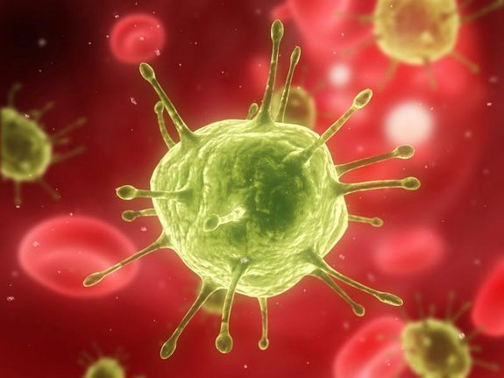
HIV
The HIV virus infects T cells and slowly replicates until it causes AIDS, which causes progressive failure to the human immune system and leads to life threatening infections and/or cancer.

Slide 4

HIV
Spread by bodily Fluids
Most effective weapon is just taking preventative measures.

Slide 5
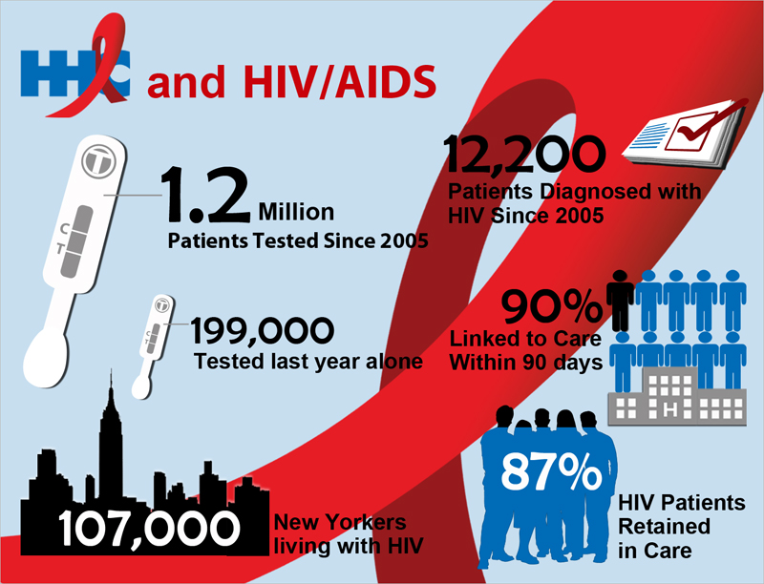
HIV
Over 1,000,000 people living with HIV in U.S.
One in five living with HIV is unaware of their infection.

Slide 6
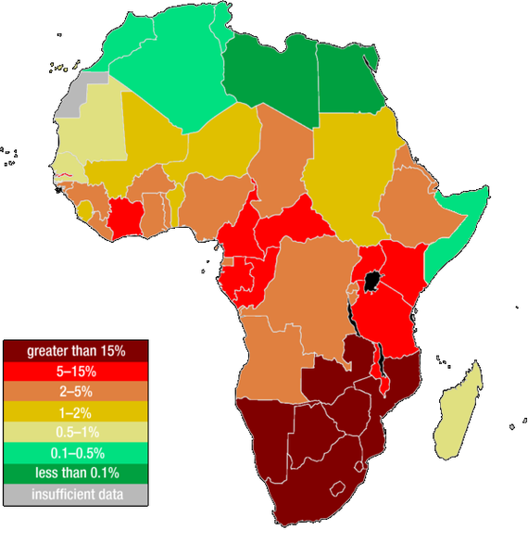
HIV in Africa

Slide 7

HIV
No cure, but there is treatment that increases the # of T-Cells or it stops the life cycle of the virus
I would rate this virus a 9 for danger

